Slide 1
Sequence assembly with Codoncode aligner

Slide 2
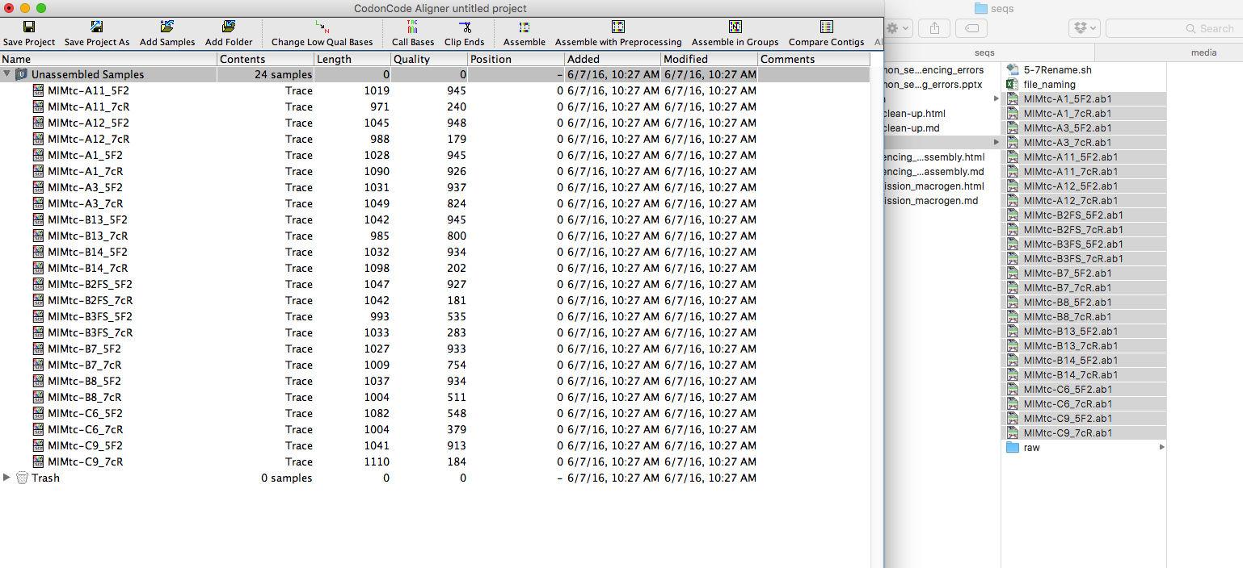
Open files in codoncode aligner or you can also drag the file

Slide 3
Select preferences to adjust parameters as needed (usually default parameters are fine):
Clipping parameters (removed bad sequences)
Assembly parameters
Other adjustments

Slide 4
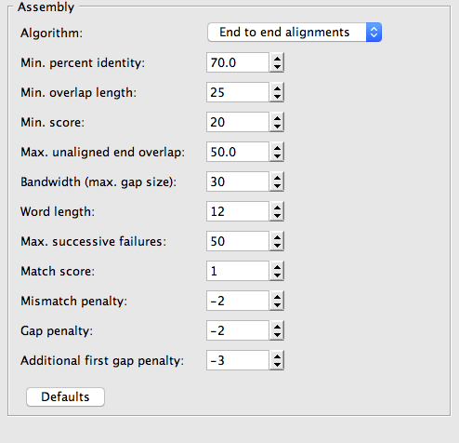
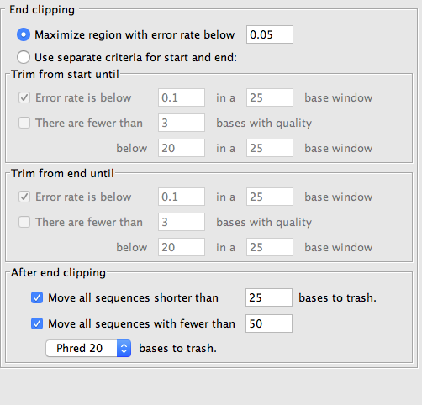
Assembly parameters
Clipping parameters

Slide 5
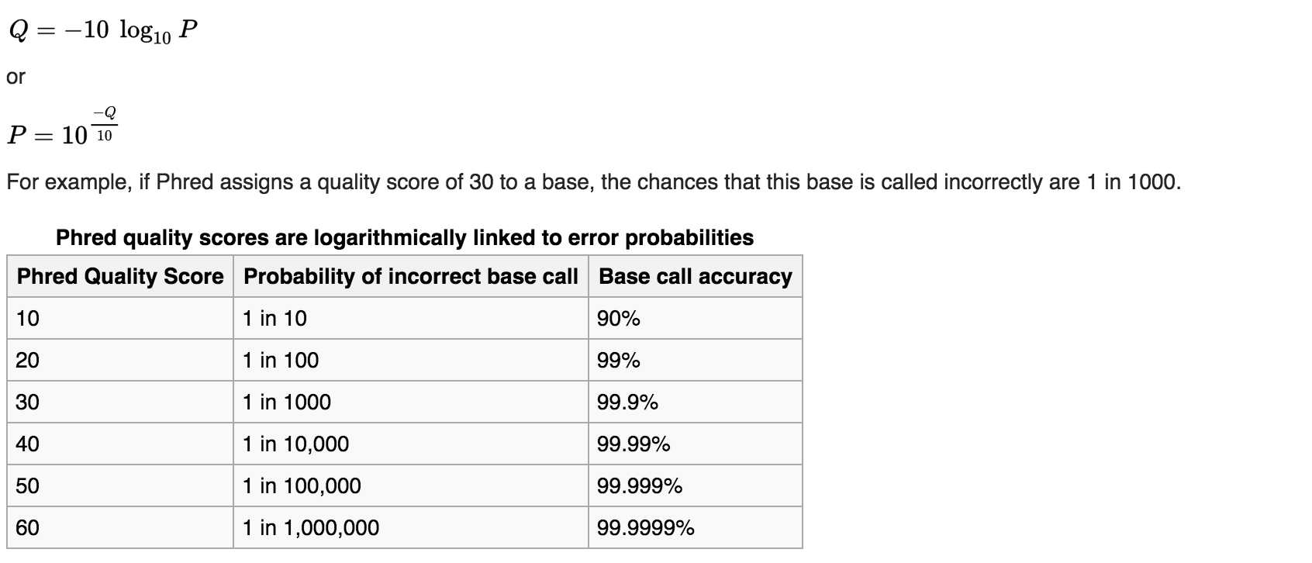
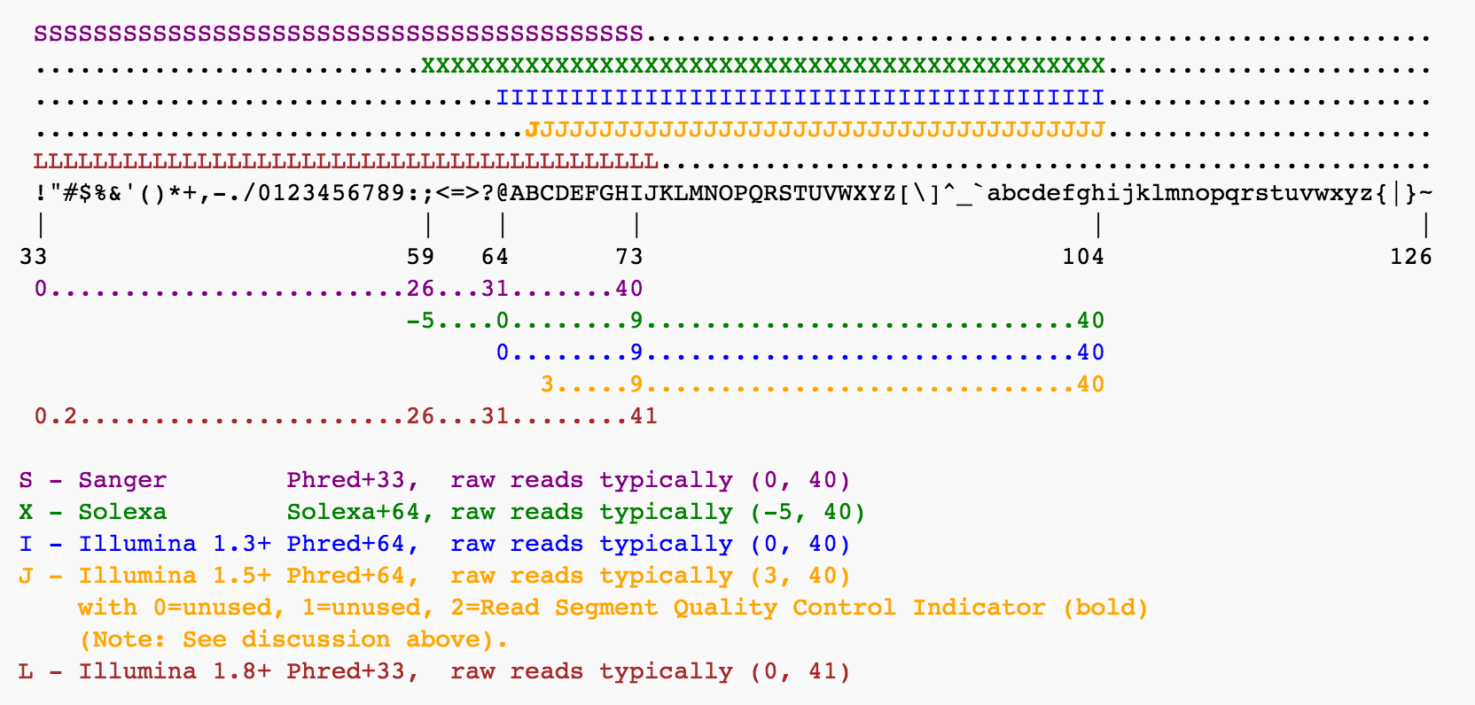
Phred quality score

Slide 6
Click on call bases, if necessary. files will be removed and new files will be generated with the corrected quality values

Slide 7
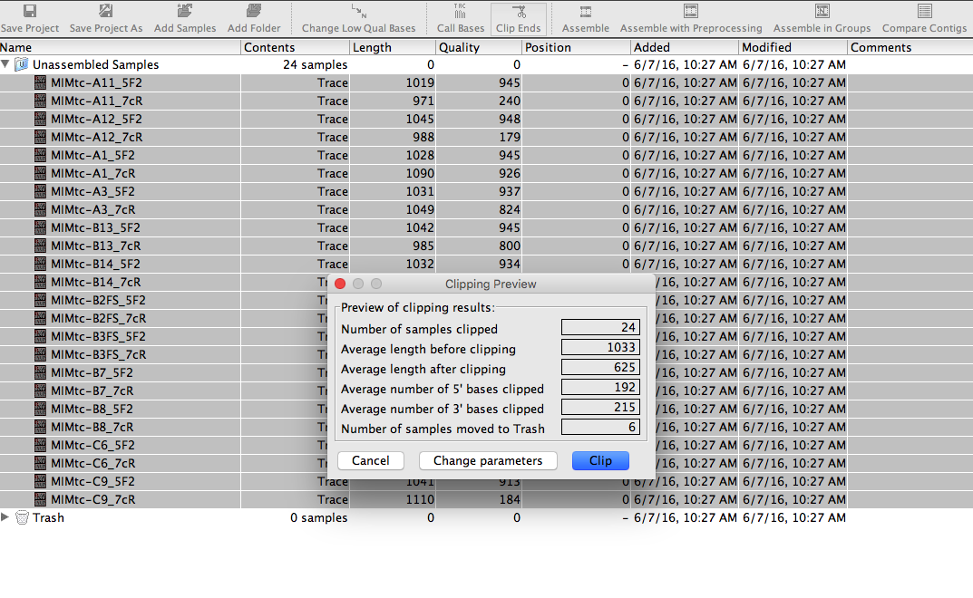
Then select all the sequences and click on clip bases

Slide 8
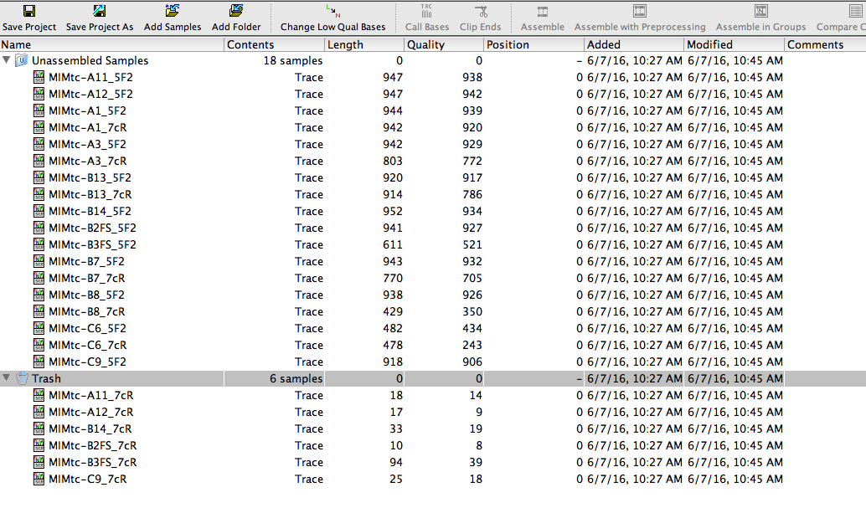
Some sequences did not pass the quality threshold, so they were moved to the trash

Slide 9
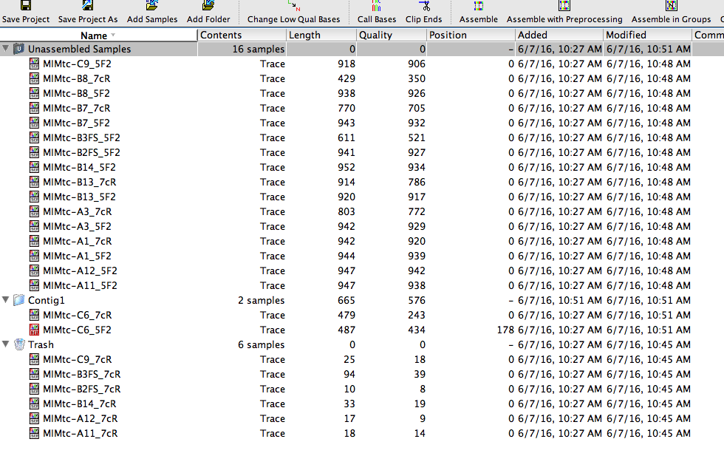
To assemble sequences there are two options, the first is to assemble manually:
Select the corresponding sequences
Hit assemble and it will generate a contig
The resulting contig will be labeled as contig1, make sure that you rename to the actual isolate name

Slide 10
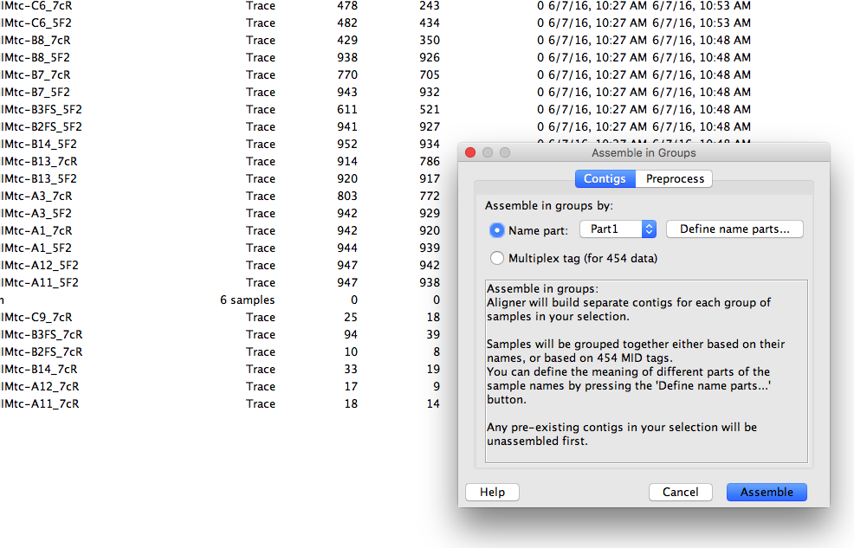
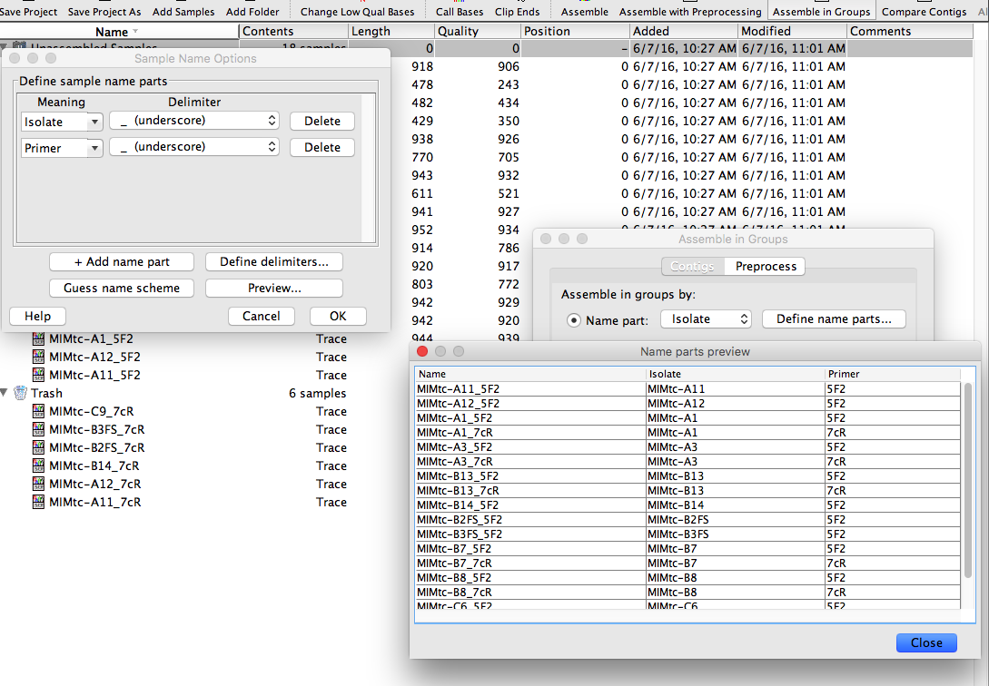
To assemble sequences there are two options, the first is to assemble manually:
Select assemble in groups
A window will pop up and the select define name parts to establish your naming system
Define the naming system and verify it before you continue by clicking on preview

Slide 11
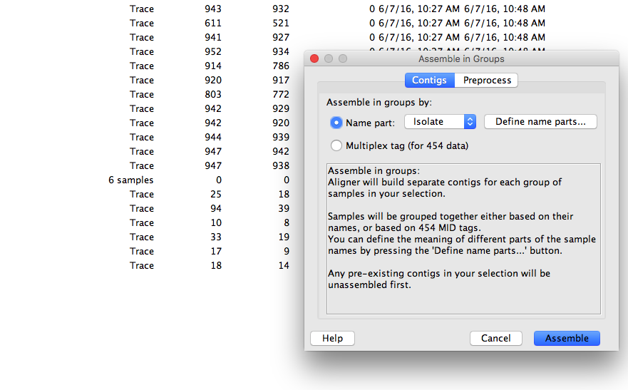
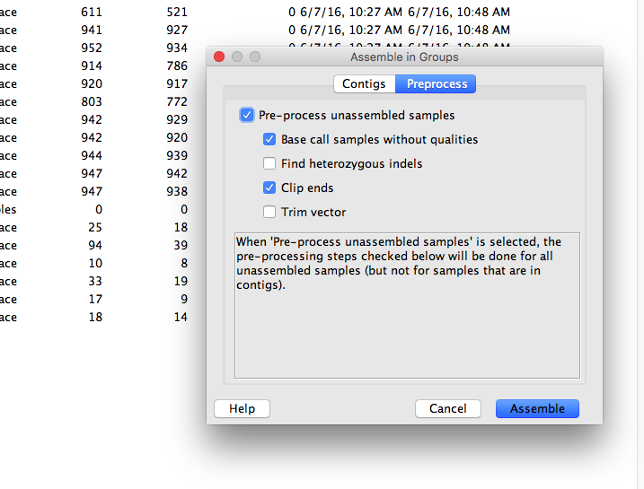
To assemble sequences there are two options, the first is to assemble manually:
Make sure that the “name part” is the correct one
There is an option for pre-processing that does what it was done in the previous steps
Click assemble and you will get contigs named with the name part selected

Slide 12
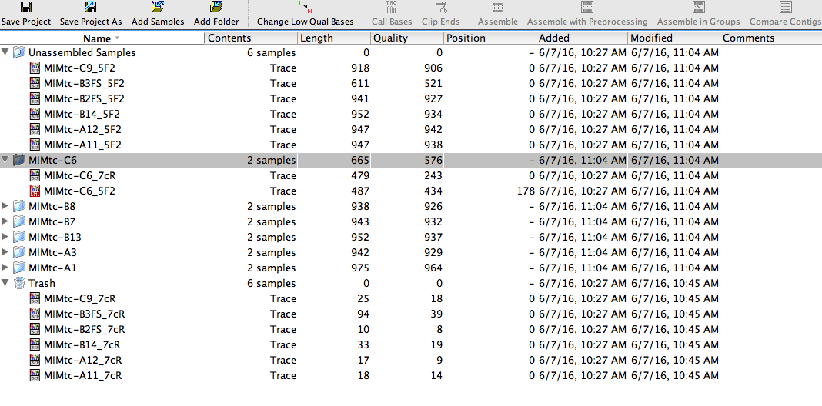
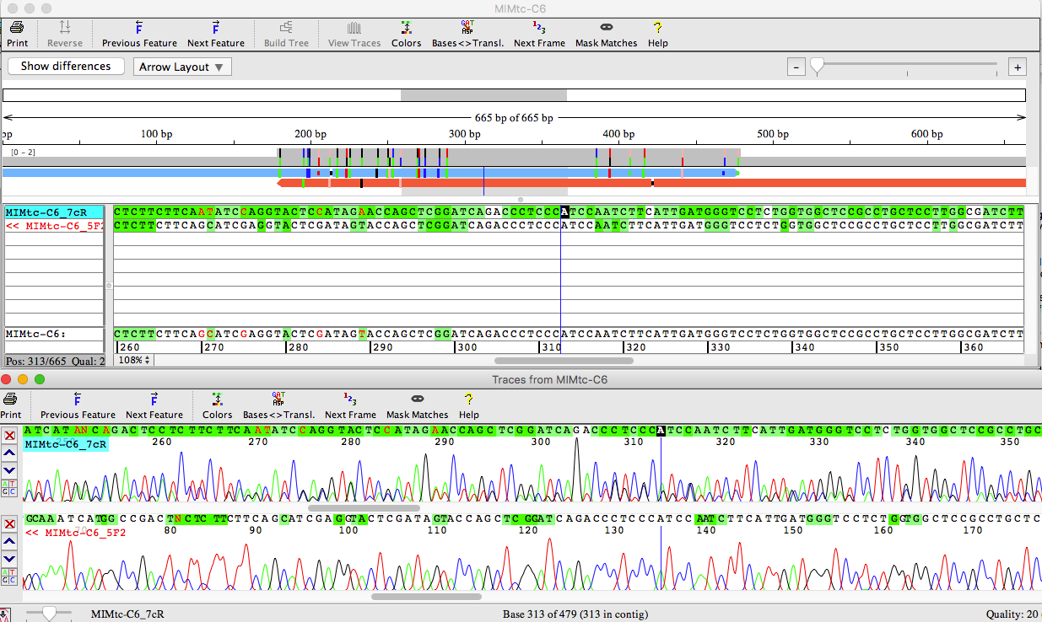
The project will look like this and the you can double click the contig folder to see chromatograms

Slide 13
Then you can go to file then select export and pick the consensus sequences and save it as fasta for further analysis

